Slide 1
Video Lick Validation
Ahamilos 2/5/24

Slide 2
The code…
Code currently in: /Users/lilis/Dropbox (MIT)/1 HAMILOS LAB/Projects/Video Lick Monitoring
Add this to your path!
Start a new video obj with:
obj = CLASS_video_lick_obj
The initialization function handles all steps! (obj = CLASS_video_lick_obj())
TIP: if you mess up a step, your progress is saved intermediately! You can always open the progress and resume the analysis steps by starting at the next step in this list

Slide 3
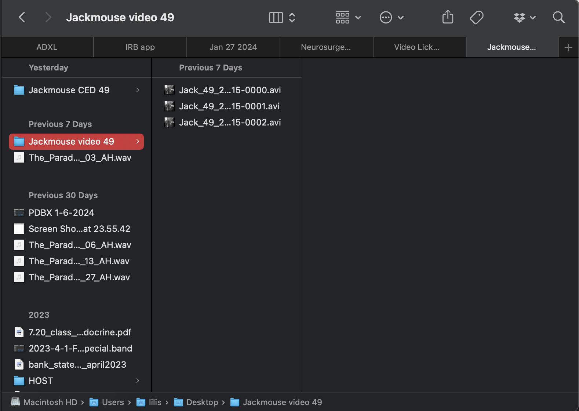
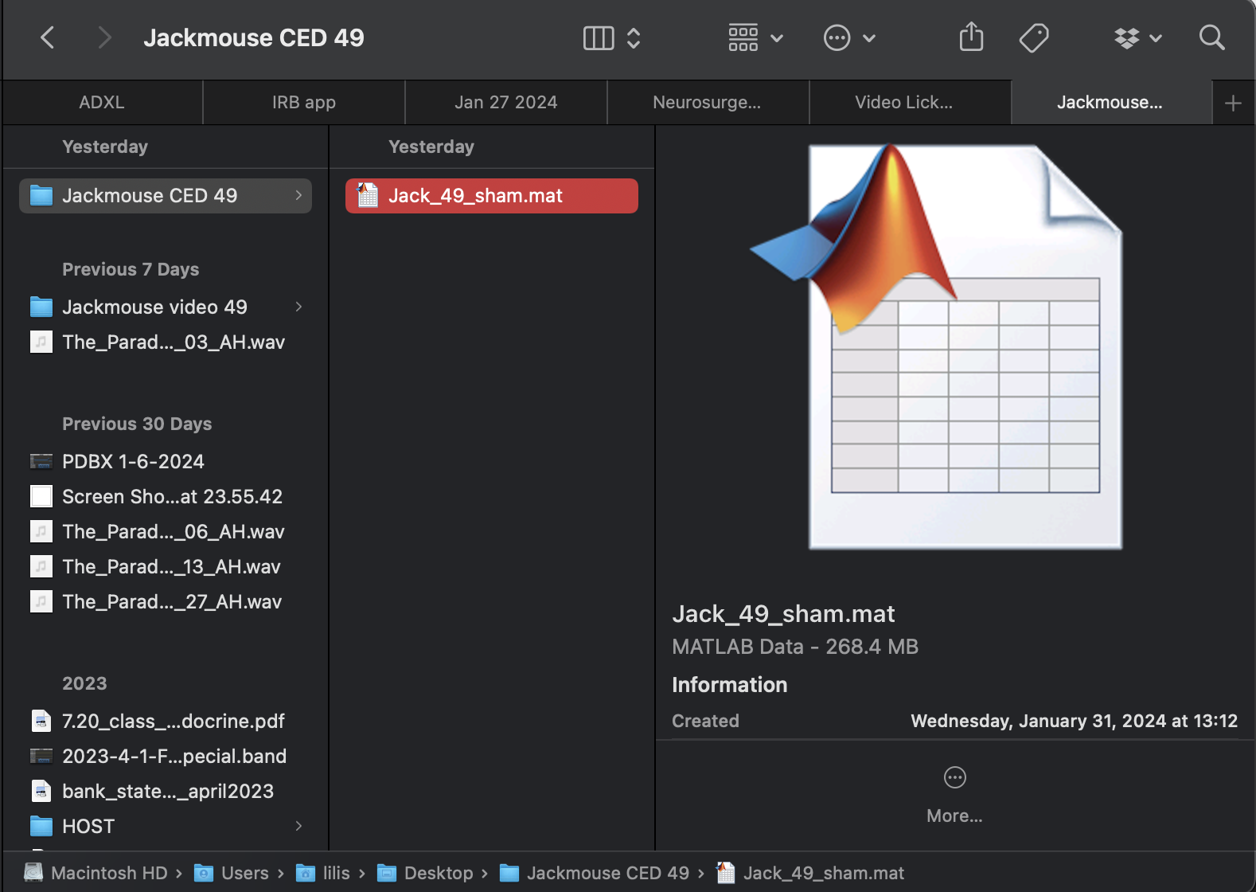
Example:
1. Video folder:
2. Selecting data files:
obj = CLASS_video_lick_obj
You will be prompted to first select the folder where the session’s videos are. Choose the Video > Name_SessionNo folder for the session of interest
TIP: Copy the video folder to the desktop – if you load from the server, it will take forever!
TIP2: Don’t include the pretraining folder in your copy! Program will get confused
You will then select the CED spike2 (.mat) file for the session. Again, will load faster if you temporarily copy it to the desktop than trying to load it from the server.
2. CED file: (.mat)

Slide 4
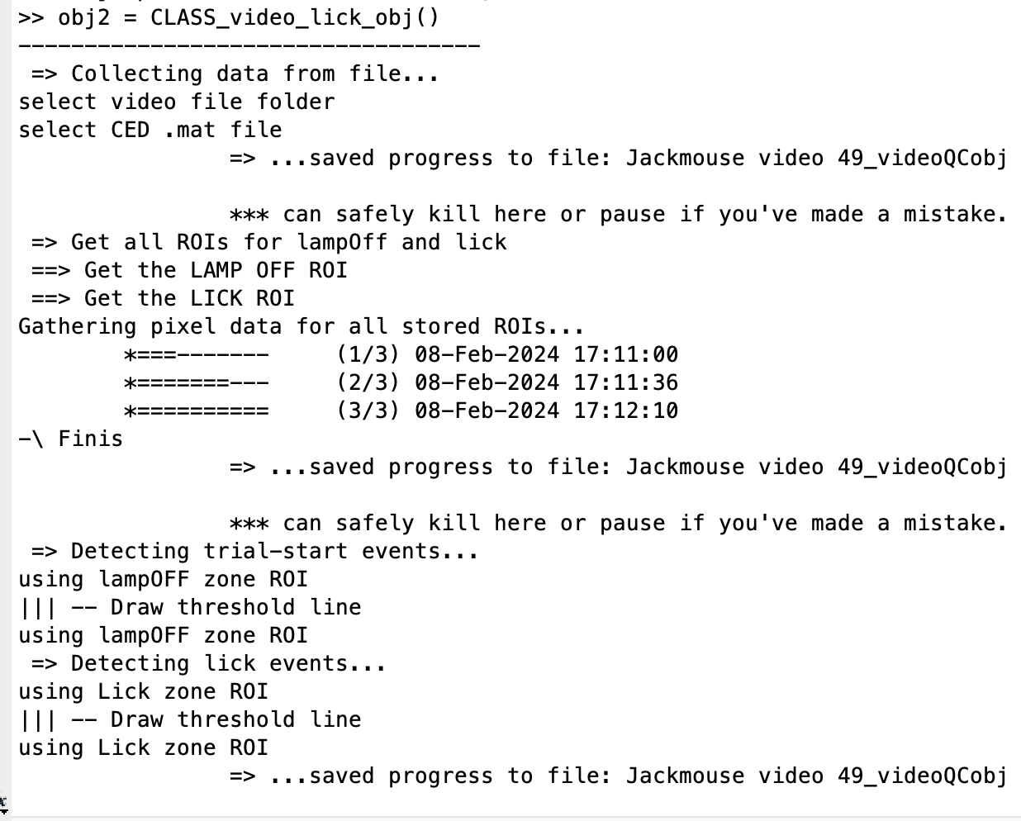
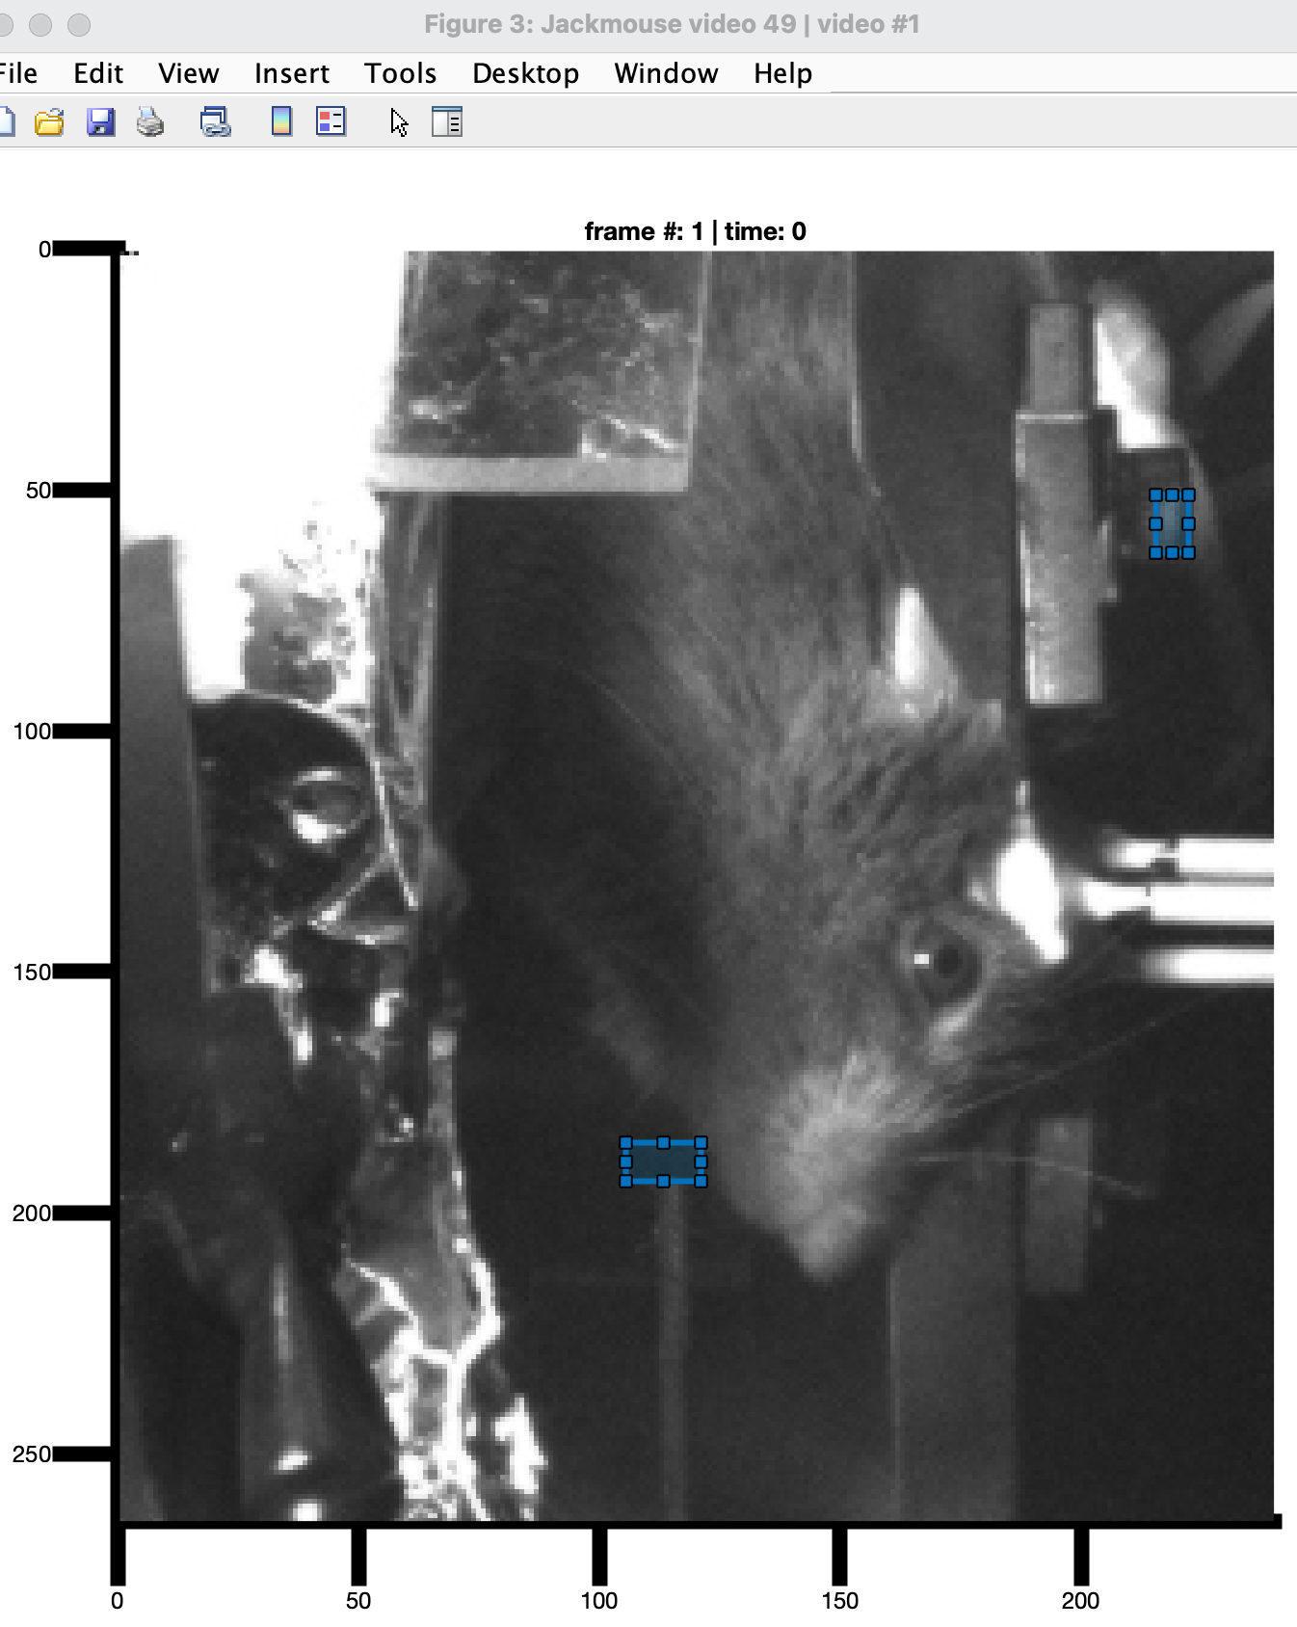
Example:
3. Selecting an ROI:
Called from init function:
obj.setAllROIs
obj.detectMultiEvents;
LAMP-OFF: Click and drag on the image to make a rectangle over the BRIGHT part of the screw
LICK: Click and drag on the image to make a rectangle near the spout
Tip: be sure to draw right at spout edge for best results
Code will take about 30s/video to run

Slide 5
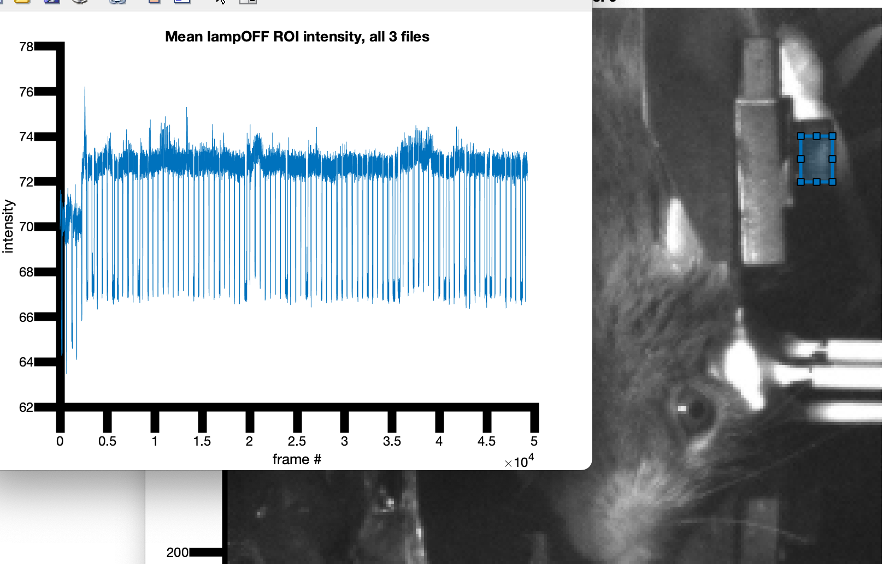
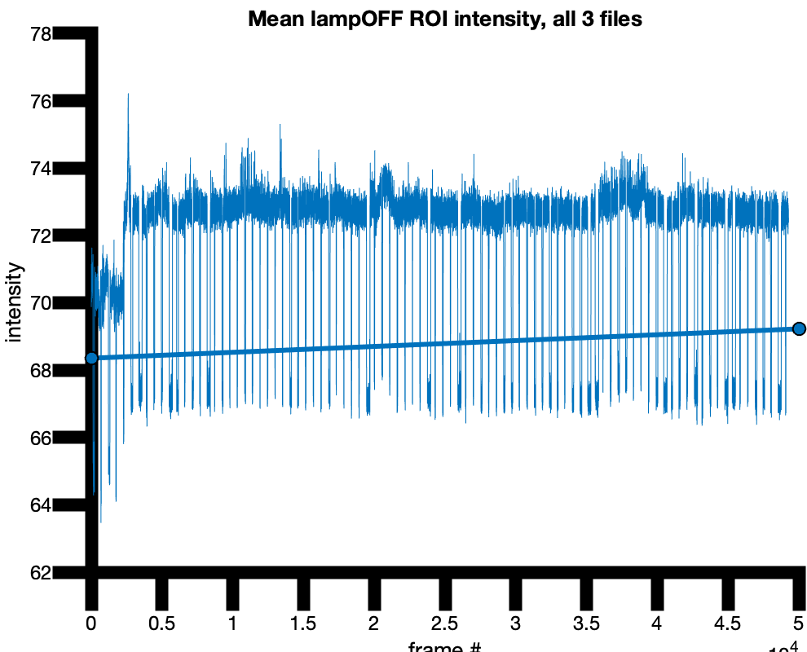
Tip! ROI selection makes a big difference
Your LampOff LOI should produce a threshold plot like this that’s easy to draw a line…

Slide 6
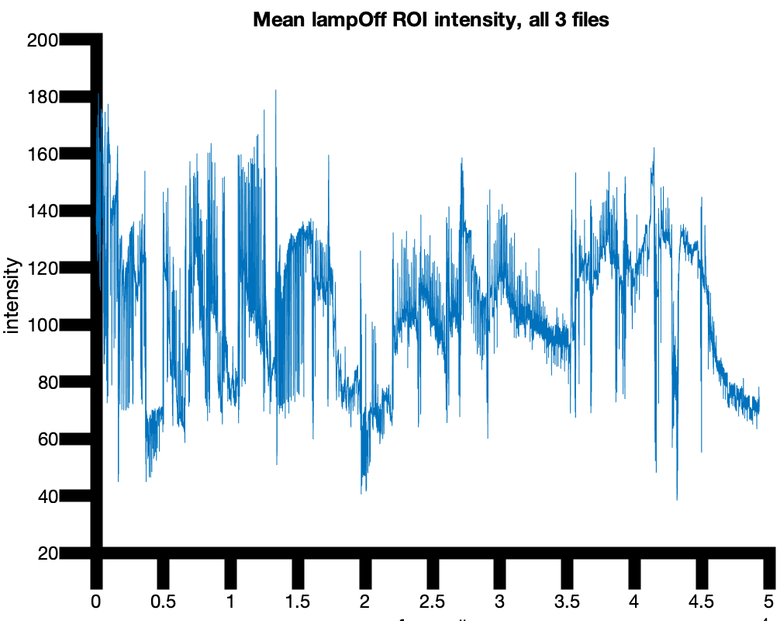

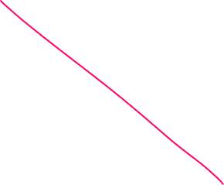
Tip! ROI selection makes a big difference
If instead you get this, you should stop the processing, open up the partially-processed saved file, and run: obj.detectLampOff
It would be impossible to threshold this…save yourself some effort and try again
TIP: watch the video to try to find a good region to pick for lampOff

Slide 7
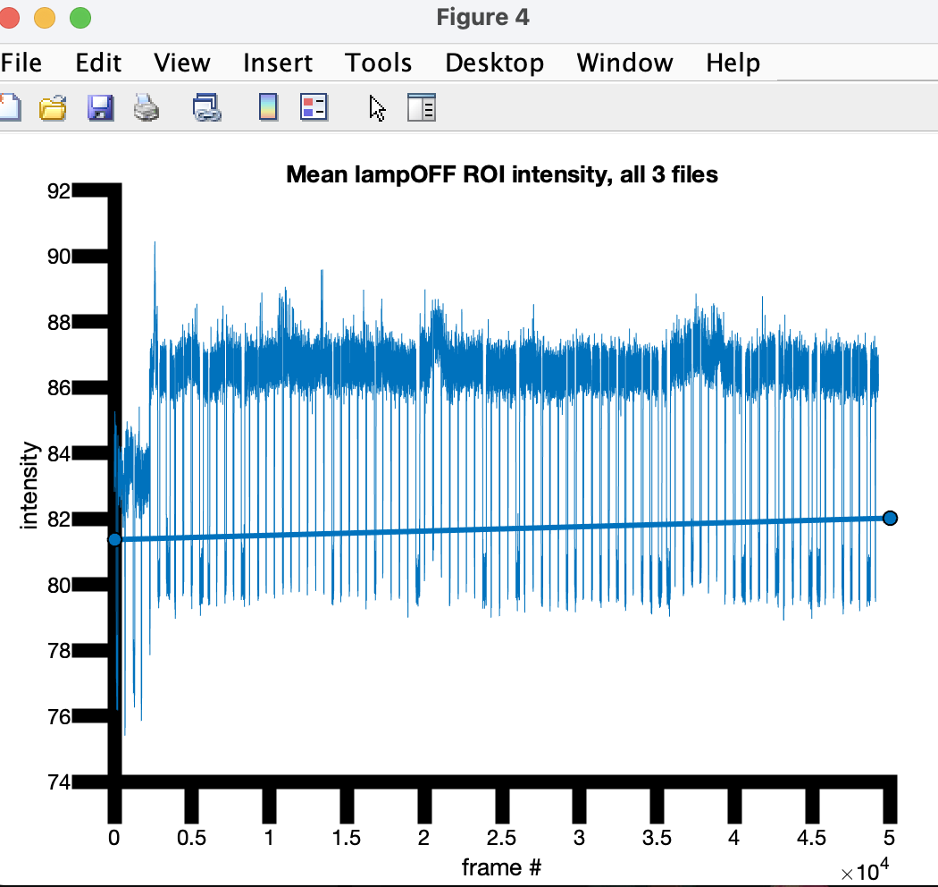
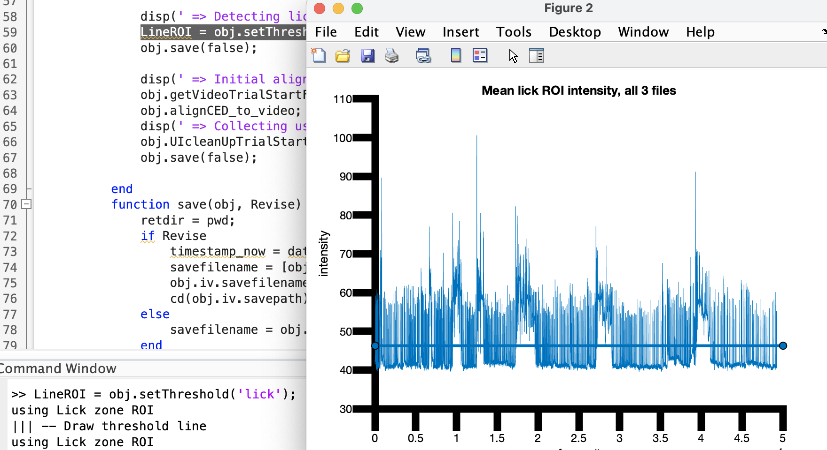
Example:
4. Gathering thresholds for event detection:
Called from init function:
LineROI = obj.setThreshold('lampOFF’);
LineROI = obj.setThreshold(‘lick’);
Click and drag on the image to make a threshold line that separates the lows from the highs
Tip: you might not be perfect, but PRIORITIZE THE BEGINNING OF THE SESH FOR ACCURACY…you will have a chance to make corrections later as long as the first lamp-off/IRtrig event is captured accurately

Slide 8
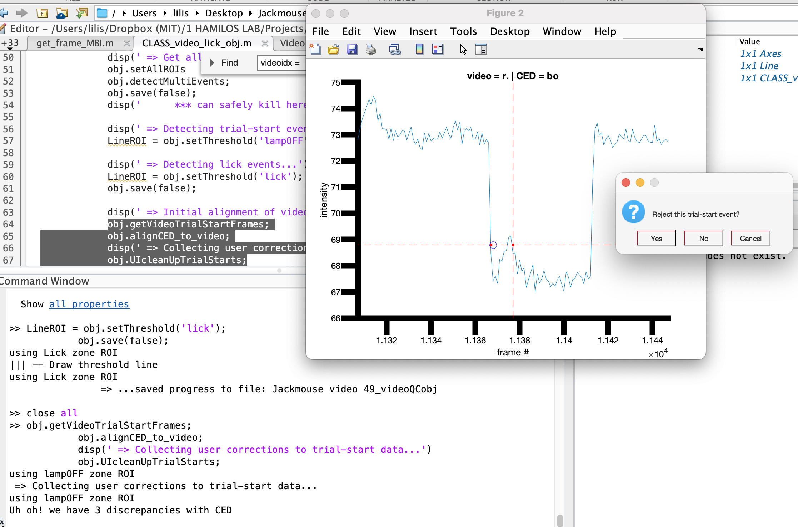
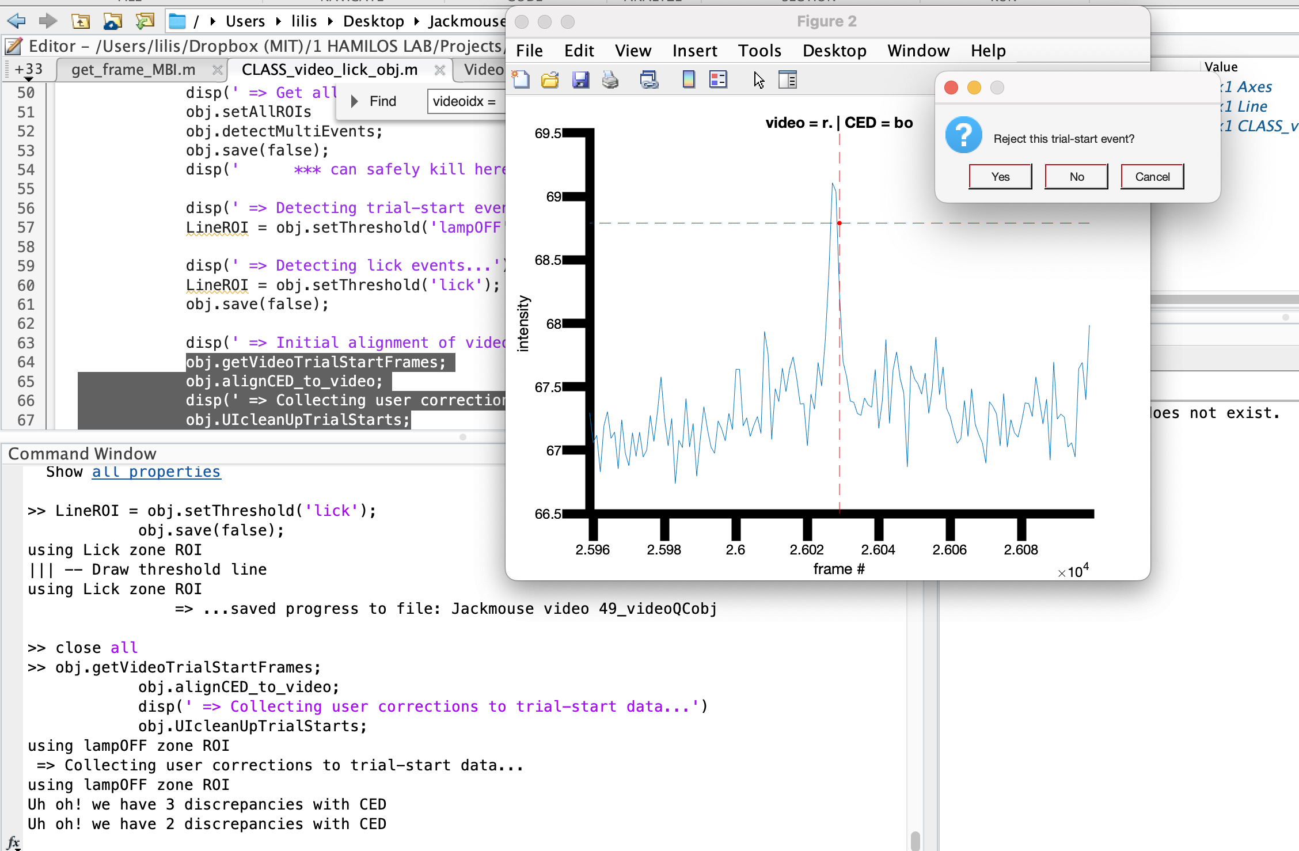
Example:
5. Automated QC on the lampOff definitions
Called from init function:
obj.getVideoTrialStartFrames;
obj.alignCED_to_video;
obj.UIcleanUpTrialStarts;
The video often hallucinates transitions. Having a good ROI helps…but obj.UIcleanUpTrialStarts will allow you to manually curate events to remove hallucinated trialstarts
Press ‘yes’ to reject an event, ‘no’ to keep
Will continue till all discrepancies are resolved.
Press cancel to stop.
This should be rejected!
This one, too!

Slide 9
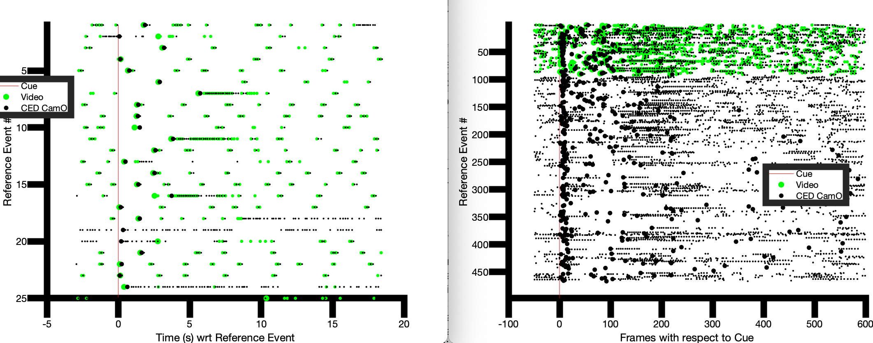
Example:
6. Gathering lick events wrt cue
Called from init function:
obj.getVideoLicks;
obj.gatherLicks;
obj.plotLicksByTime;
We plot the initial assignment of lick timestamps from video vs the CED
Version notes: Video doesn’t detect grooming touches because it is not looking for spout peaks.
The video lick leads the spout contact by up to ~100ms, as expected from EMG

Slide 10
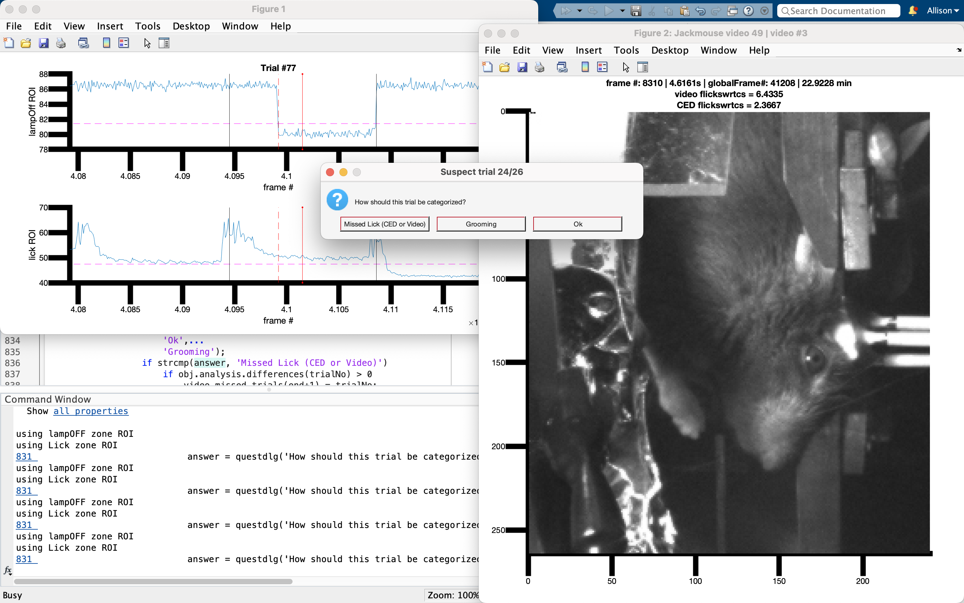
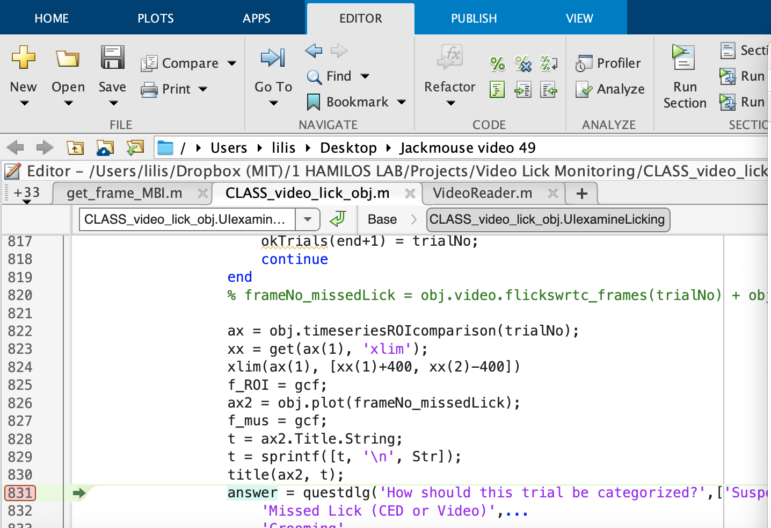
Example:
9. Assisted Manual Curation of Missed Licks vs Grooming
obj.UIexamineLicking(threshold_to_examine)
The program finds all first-licks where the difference in timestamps between CED and Video is < some threshold to examine. Conservatively, we set this threshold to 0.1s for testing. It looks like up to 150ms is within the range of error.
TIP: drop a stop sign on the dlg box line of the function so that you can examine the plots before making a curation decision!
Try obj.plot(frameNo)for any frames you’d like to check out before deciding

Slide 11
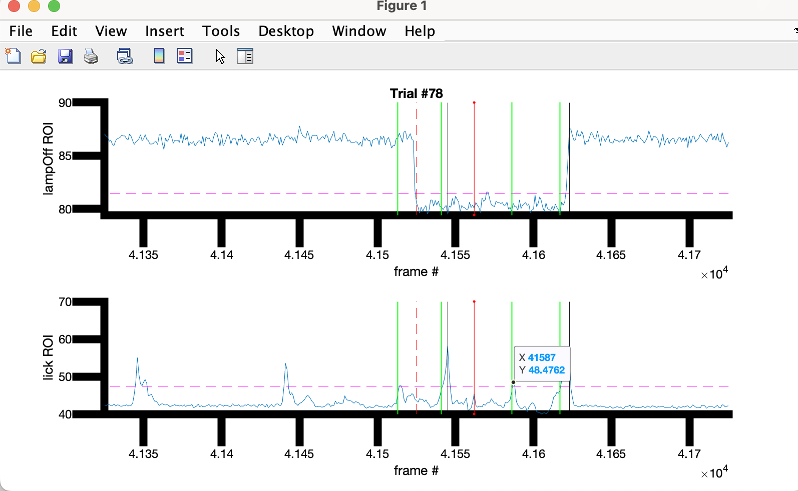
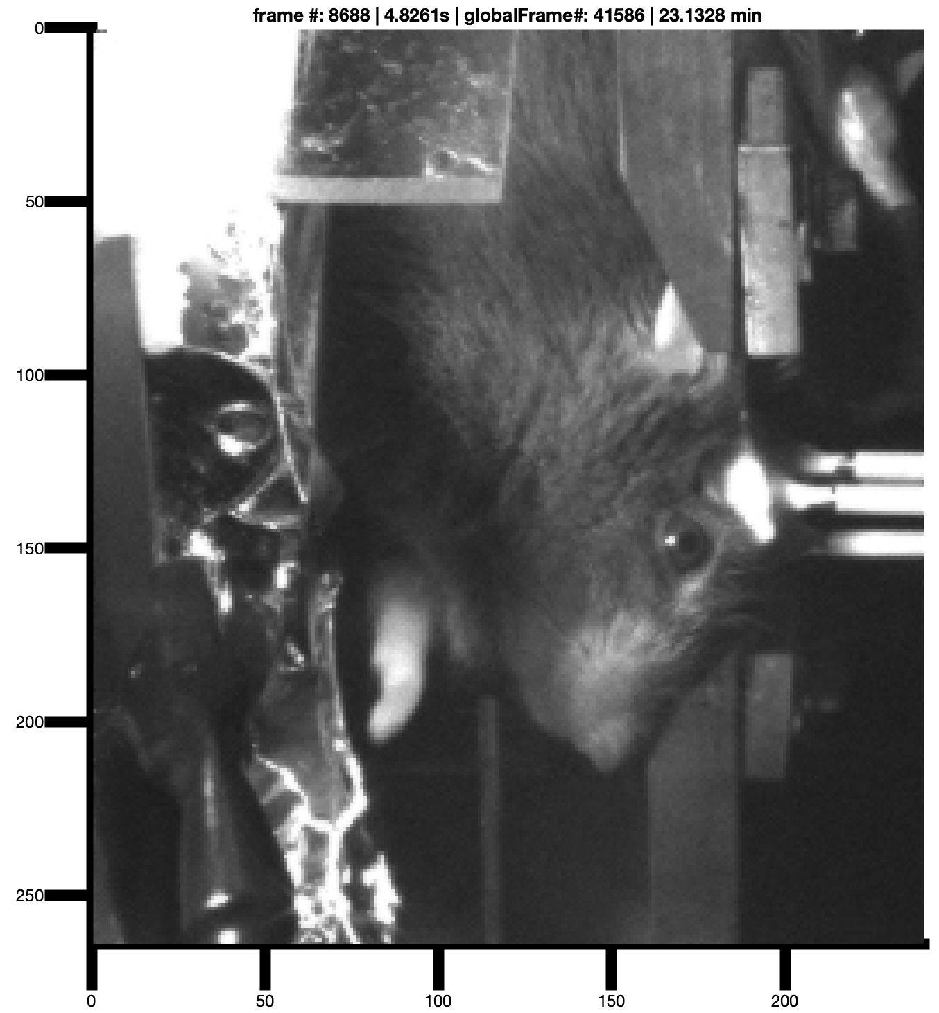

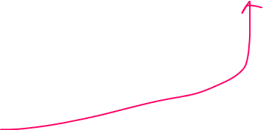
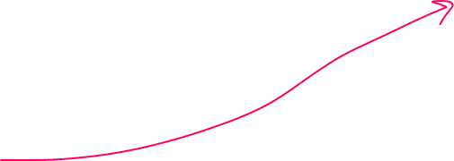
Patterns of Assisted Curation
Problematic lick?:
Thick red: cue
Green: Video licks
Black: CED lick
Note how the lick ROI shows an increase well before the lampON event…we need to examine this frame
Click on the lick ROI plot to find the frameNo (it’s 41587!), then try:
obj.plot(41587) %and a few frames around this
We see the mouse is scurrying! This isn’t a false detection.
We thus mark the trial as OK
This lick is ok!

Slide 12
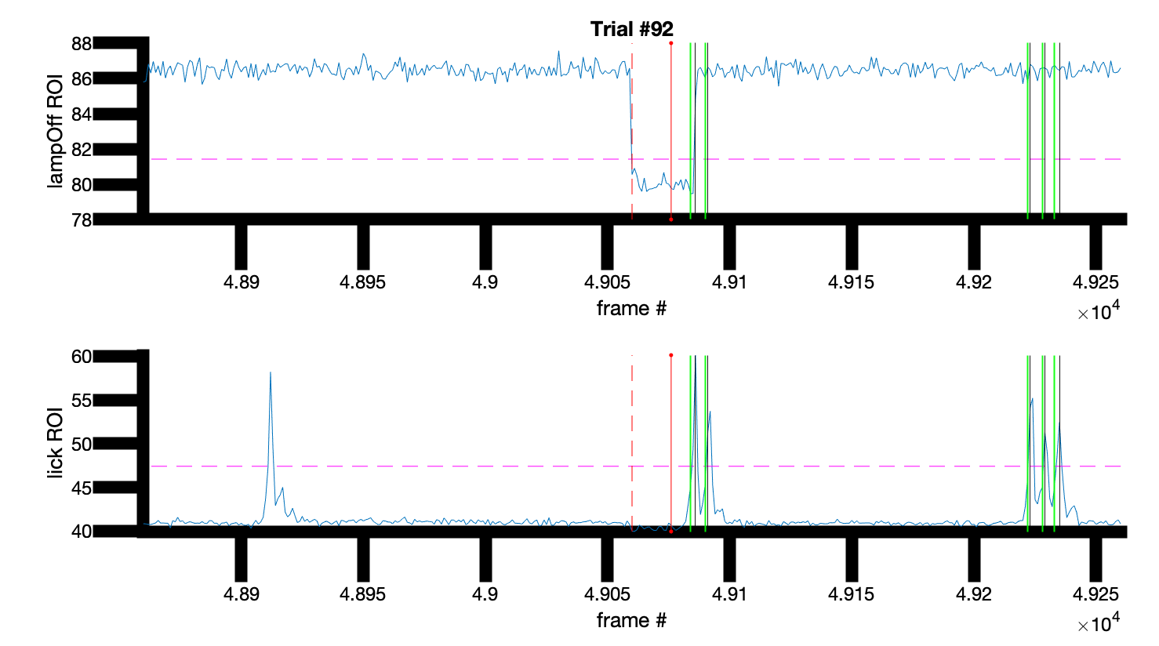
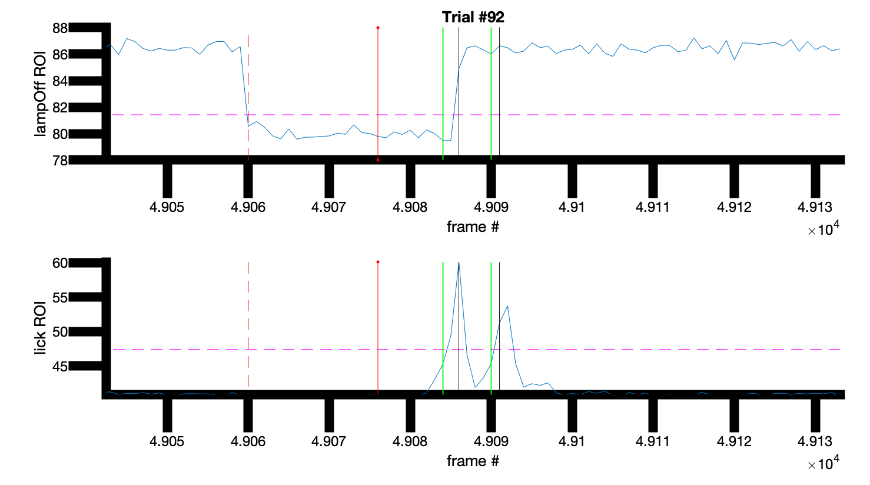



Patterns of Assisted Curation
This lick is ok!
Problematic lick?:
Dashed red: LampOff
Thick red: cue
Green: Video licks
Black: CED lick
Note how the green happens on the up-swing of the lick—it’s nearly the same time as the lamp-off. This lick is ok—the video just detected a little faster than CED because the tongue was captured in flight before contacting the spout!
If you’re not sure, try zooming in on the ROI plot!

Slide 13
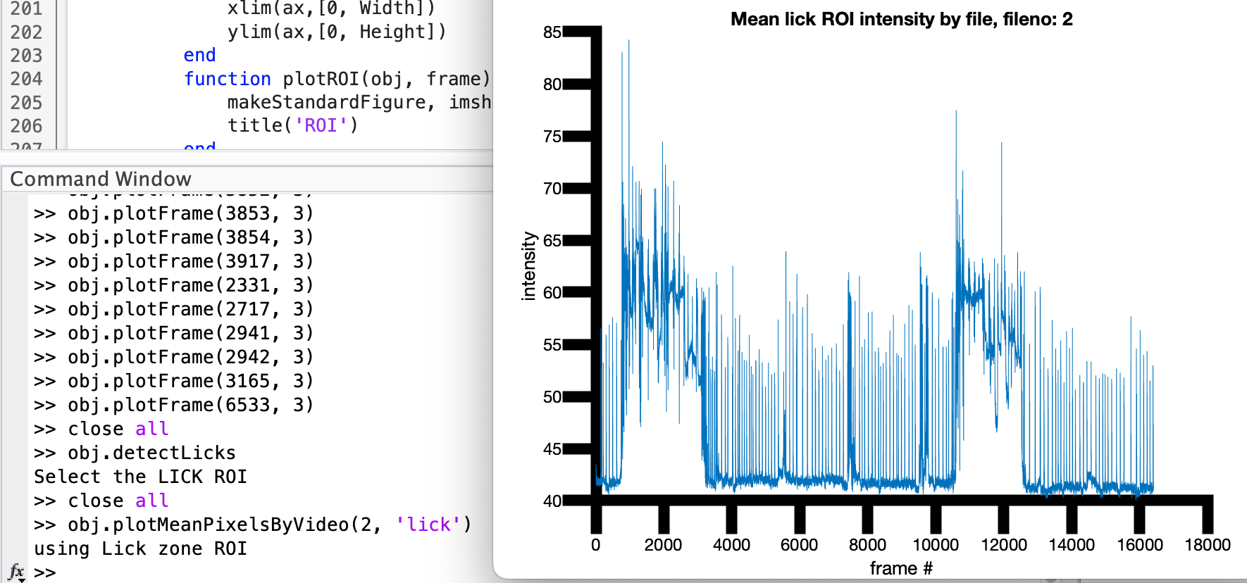
Example:
View lick data from a single video
obj.plotMeanPixelsByVideo(video_number, 'lick’)
The mean intensity of the ROI is plotted by frames in the video.

Slide 14
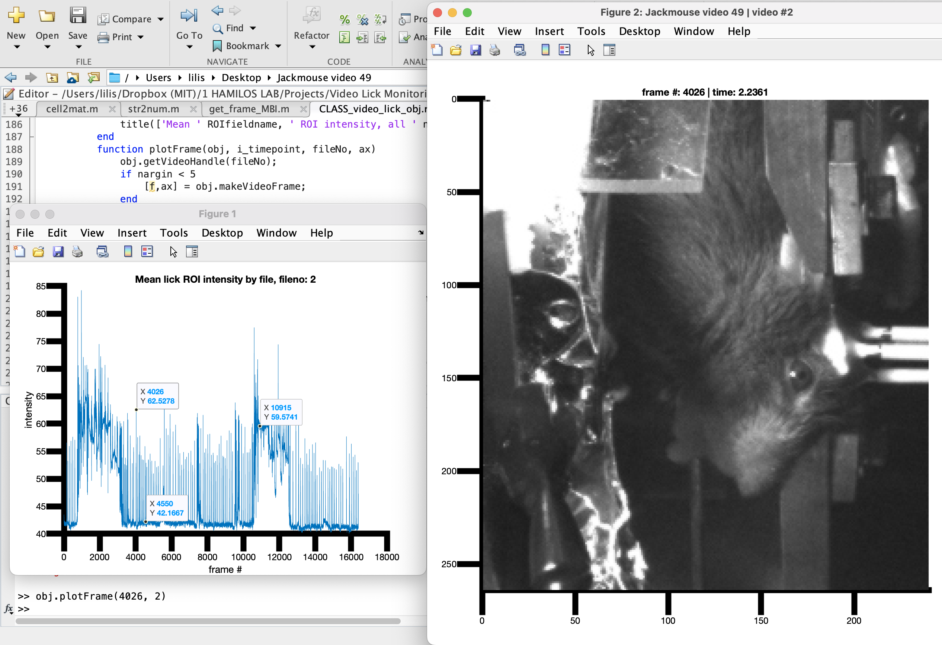
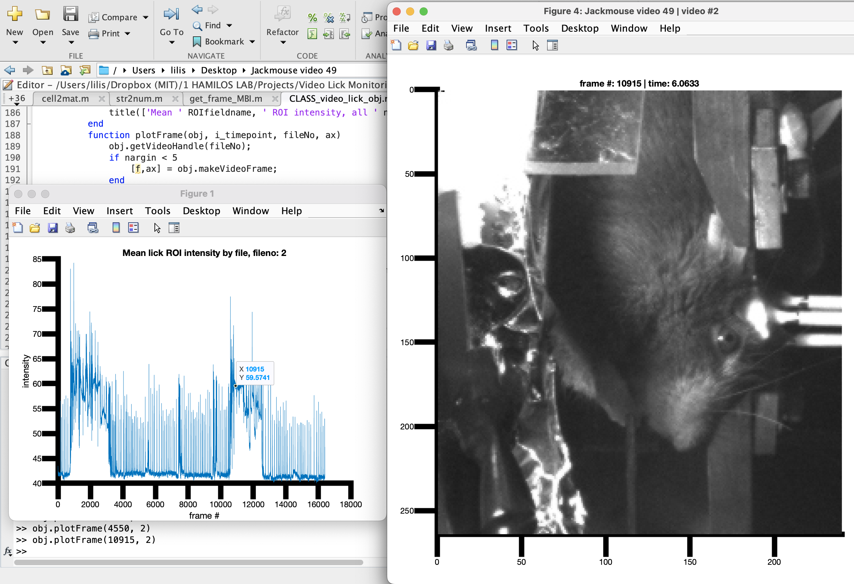

Example:
Lick event
View lick data from a single video
obj.plotMeanPixelsByVideo(video_number, 'lick’)
Try clicking with the marker tool to find frames of interest.
You can then observe the frame with obj.plotFrame(frameNo, video_number)
Licking, grooming and “teeth grinding” are all easily detectable!
Grooming bout
At rest

Slide 15
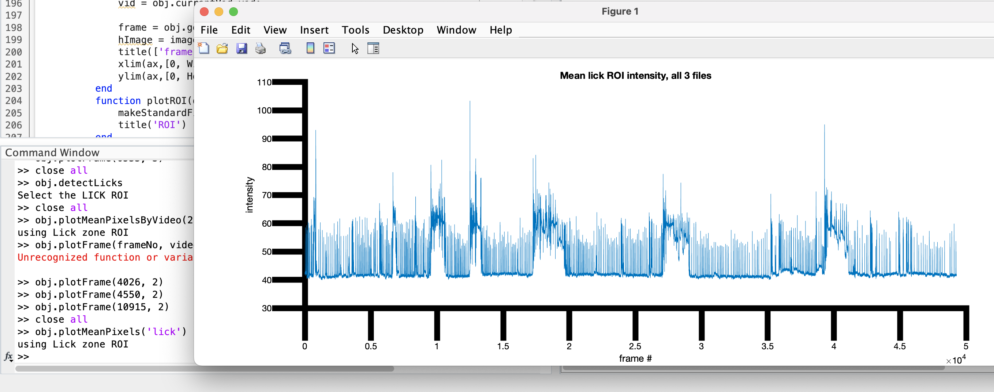
Example:
View lick data from the entire session
obj.plotMeanPixels('lick’)
The mean intensity of the ROI is plotted by frames, concatenating them across videos.
Here, we have a high level view of grooming and licking behavior.

Slide 16
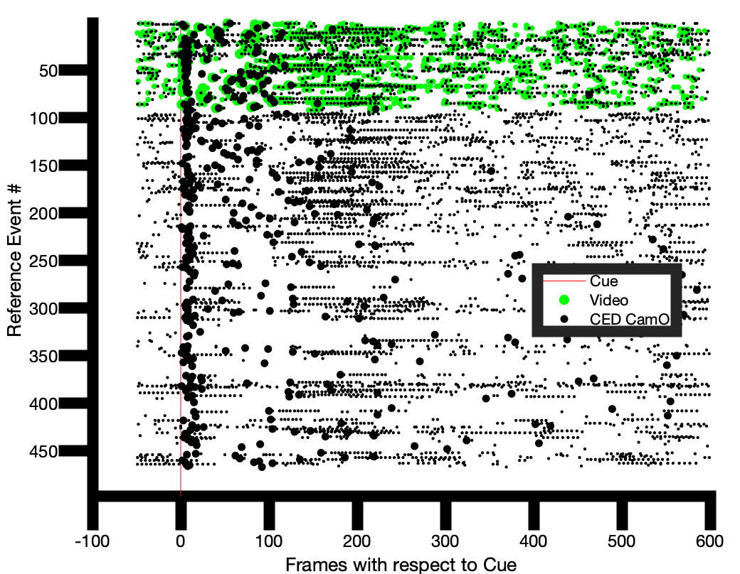
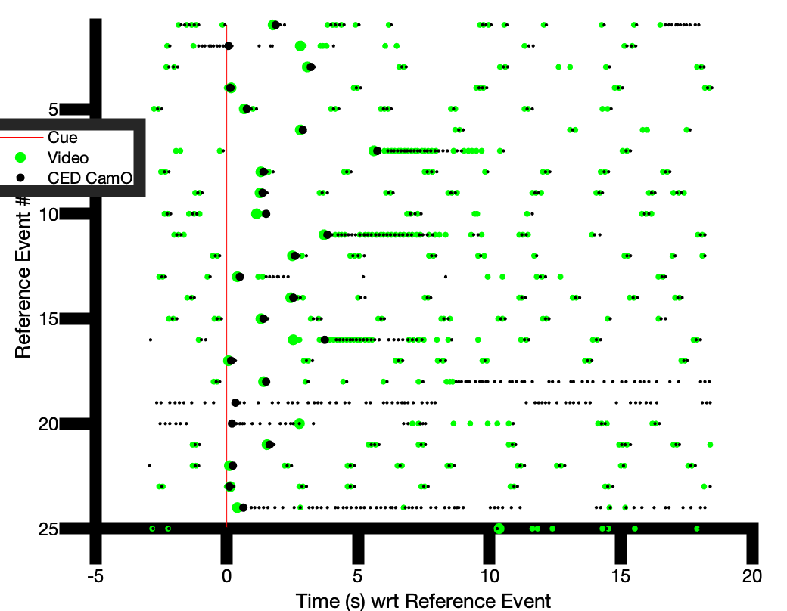
Example:
View lick rasters in units of frames or seconds
obj.plotLicksByTime
obj.plotLicksByFrames
These rasters agree – here we are plotting VIDEO IN GREEN and CED stamps in black

Slide 17
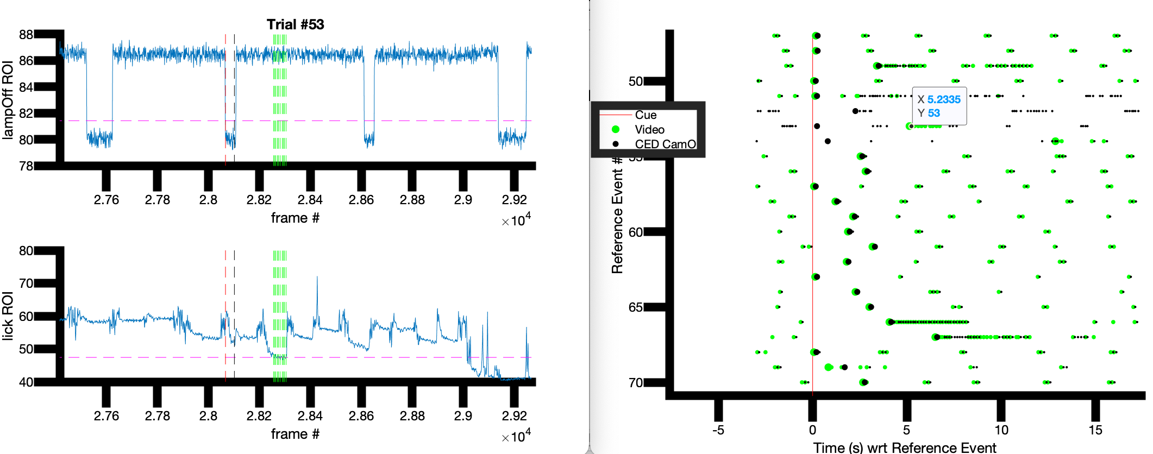
Example:
Identifying sources of odd behavior
ax = obj.timeseriesROIcomparison(trialNo);
Trial 53 in the example looks odd. We ran ax = obj.timeseriesROIcomparison(53); and identified that this was a trial with a lot of grooming. The grooming happened to exceed threshold briefly in the middle, leading to this odd behavior of the lick detector.
TIP: Running ax = obj.timeseriesROIcomparison(trialNo, ax) allows us to recycle the plot for other exploration

Slide 18
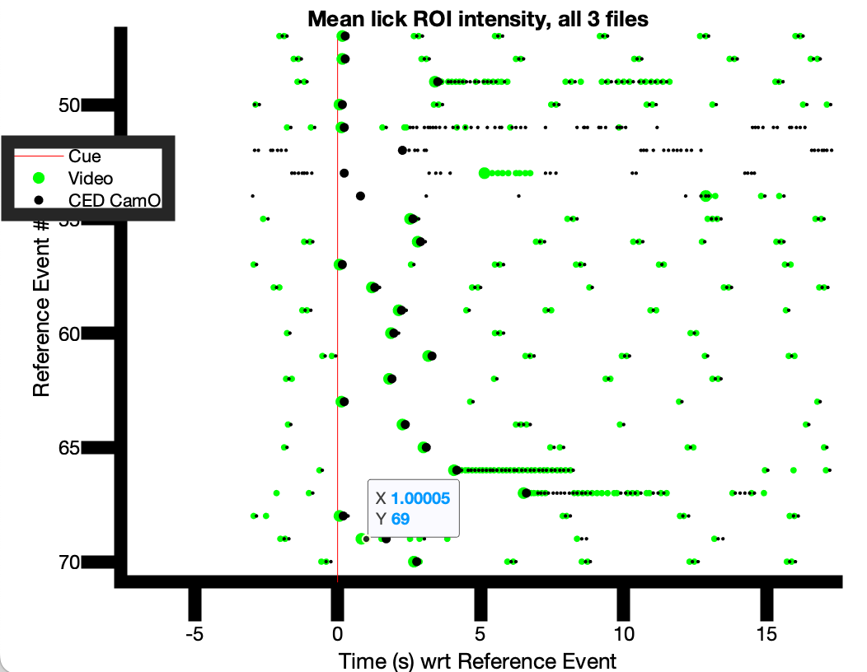
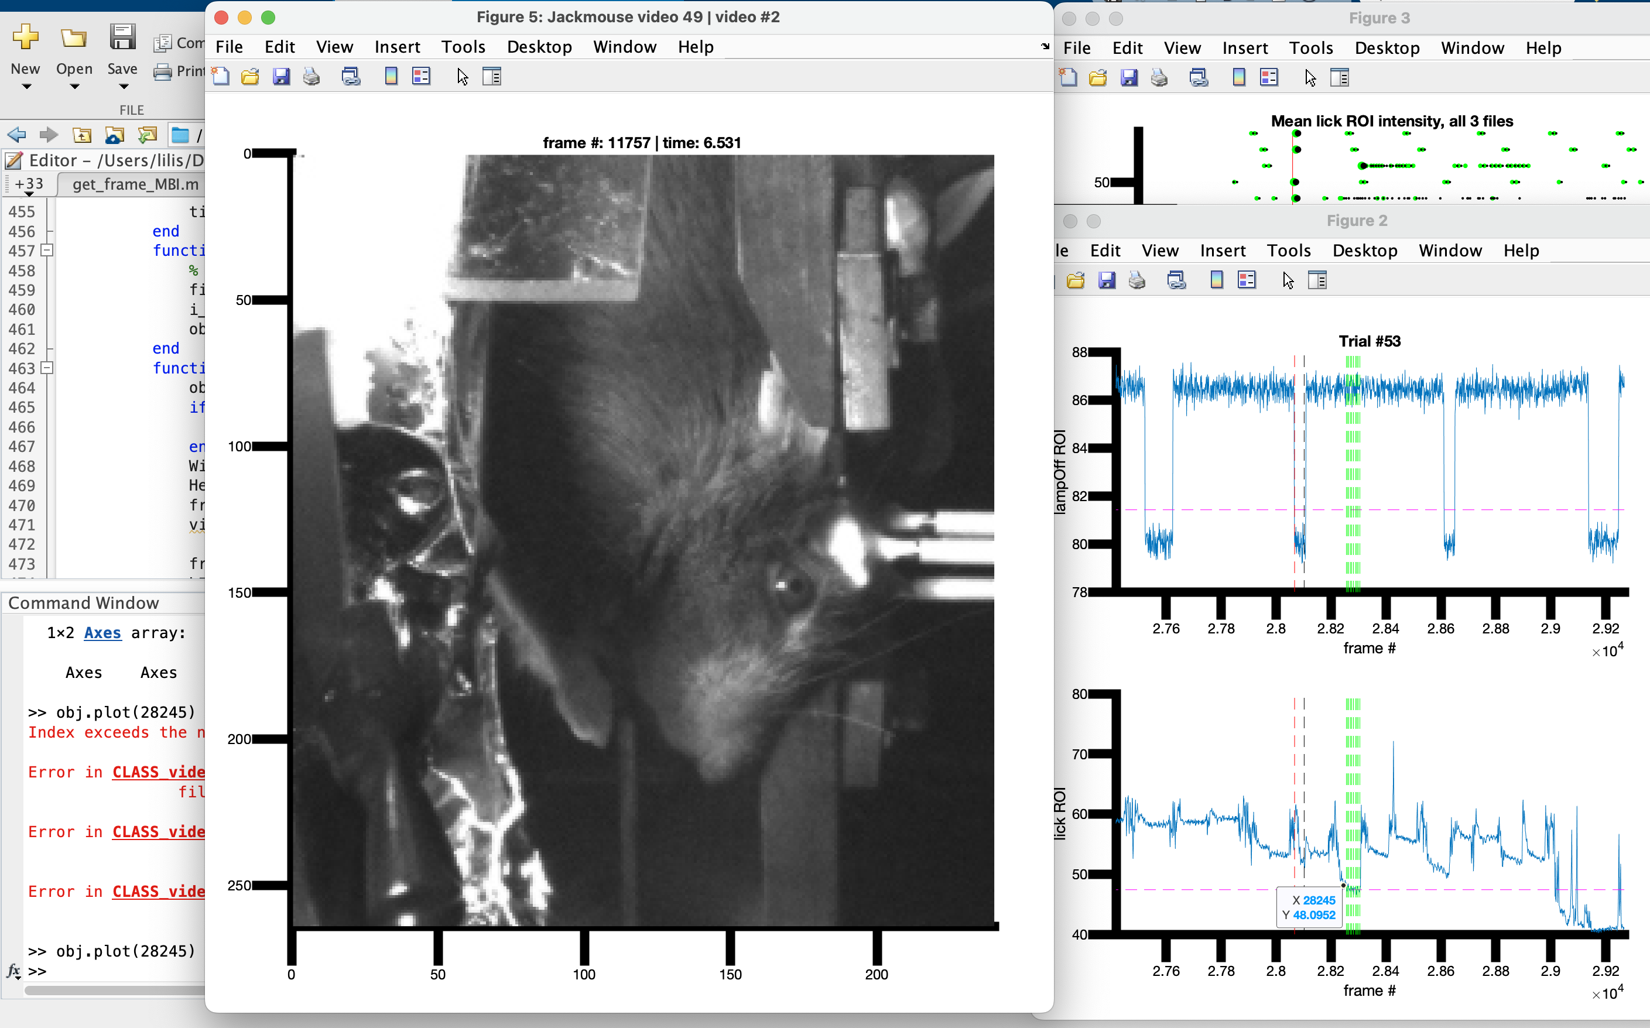
Example:
Identifying sources of odd behavior
ax = obj.timeseriesROIcomparison(trialNo);
obj.plot(globalFrameNo)
Trial 69 in the example looks odd. We ran ax = obj.timeseriesROIcomparison(69); and identified that this was a trial with some either grooming or small face movements. We then plotted the frame by clicking on the time of interest on the timeseries, which revealed the mouse had his paws up!

Slide 20
Next steps
Find trials in which there is larger than chance discrepancy in flick time
(forgot to do as hxg…would be nice) Write function to draw a threshold based on histogram of intensities of ROI across session
Basically, want the user to be able to look at distribution of intensities and identify a threshold level to use for identifying licks or suspected grooming events
Automate exclusion of grooming trials
Add a function to identify which trials grooming occurs in
Be sure grooming impacted the first-lick on that trial
Have the function spit out the exclusion list
**may need to set different thresholds for grooming and check the results before accepting automated decisions!

Slide 21
The code…
Code currently in: /Users/lilis/Dropbox (MIT)/1 HAMILOS LAB/Projects/Video Lick Monitoring
Add this to your path!
Start a new video obj with:
obj = CLASS_video_lick_obj
Gather the lick data with:
obj.detectLicks
You will need to select an ROI around the spout
You can then view the lick data for an individual data with:
obj.plotMeanPixelsByVideo(video_number, 'lick’)
This will make it easy to find a frame in a specific video to view:
obj.plotFrame(frameNo, video_number)
You can also view the lick data for the entire session with:
obj.plotMeanPixels('lick')

Slide 22
Example:
1. Video folder:
2. Selecting data files:
obj = CLASS_video_lick_obj
You will be prompted to first select the folder where the session’s videos are. Choose the Video > Name_SessionNo folder for the session of interest
TIP: Copy the video folder to the desktop – if you load from the server, it will take forever!
TIP2: Don’t include the pretraining folder in your copy! Program will get confused
You will then select the CED spike2 (.mat) file for the session. Again, will load faster if you temporarily copy it to the desktop than trying to load it from the server.
2. CED file: (.mat)

Slide 23
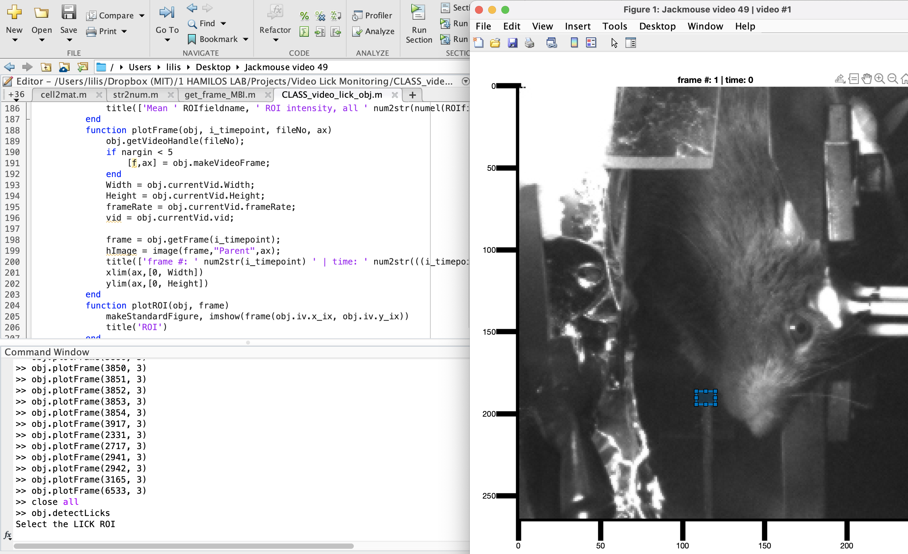
Example:
3. Selecting an ROI:
obj.detectLicks
Click and drag on the image to make a rectangle near the spout
Tip: be sure to draw right at spout edge for best results
Code will take a few min to run

Slide 24
Example:
4a. View lick data from a single video
obj.plotMeanPixelsByVideo(video_number, 'lick’)
The mean intensity of the ROI is plotted by frames in the video.

Slide 25
Example:
Lick event
4b. View lick data from a single video
obj.plotMeanPixelsByVideo(video_number, 'lick’)
Try clicking with the marker tool to find frames of interest.
You can then observe the frame with obj.plotFrame(frameNo, video_number)
Licking, grooming and “teeth grinding” are all easily detectable!
Grooming bout
At rest

Slide 26
Example:
5. View lick data from the entire session
obj.plotMeanPixels('lick’)
The mean intensity of the ROI is plotted by frames, concatenating them across videos.
Here, we have a high level view of grooming and licking behavior.

Slide 27
Quality checks
obj.UIcleanUpTrialStarts
Once CED and video data is loaded in, we need to clean up any hallucinated trials with video
TIP: your choice of LampOff ROI really impacts the quality of detection—small changes can make the threshold drawing very different

Slide 28
Next steps
Add Lamp-Off/IRtrig functionality to discover the first trial
Add a function obj.detectTrialStart to get ROI for lamp-off events – should be basically the same code as obj.detectLicks but should store the data elsewhere (obj.ROIs.lamp, for example)
Add a function obj.getTrialStartTimes to align camera start to CED start
Write function to draw a threshold based on histogram of intensities of ROI across session
Basically, want the user to be able to look at distribution of intensities and identify a threshold level to use for identifying licks or suspected grooming events
Automate detection of trial start events (can use to help align with CED)
Align the frames to the CED ticks (can find frame 1 and count as long as no dropped frames in the session!)
Write function to check that the lamp-off events from camera match CED lamp off events on all trials – QC for dropped frames!
Assign lick time based on thresholding of the video lick detection
Automate exclusion of grooming trials
Add a function to identify which trials grooming occurs in
Be sure grooming impacted the first-lick on that trial
Have the function spit out the exclusion list
**may need to set different thresholds for grooming and check the results before accepting automated decisions!

Slide 29
/end

Slide 30
The code…
Code currently in: /Users/lilis/Dropbox (MIT)/1 HAMILOS LAB/Projects/Video Lick Monitoring
Add this to your path!
video_lick_extractor
You select a folder with the vides for the session. It will ask you to make an ROI for the lick zone. It will then automatically process each video file to identify licks.
get_frame_MBI(vid_handle, frameNo, mouse_name, videoNumber, zoom_multiplier)
This function will allow you to plot a frame from the current video to check the lick status

